Slide 1

COURSE REGISTRATION SYSTEM
JEDI-07 GROUP 7
Notes:
2 mins for intro and roles

Slide 2
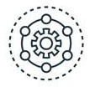
Framework
2 WEEKS OF TECH 101 & HANDS ON PROJECT
MCQ tests on alternate days based on the last topic taught and daily assignments.
Numerous 15 minutes Pulse Connects and discussion sessions with SME and trainer about the track and technologies.
Everyday demonstration of project progress report followed by extensive work review and doubt clearance session.
Problem statement followed throughout the journey as scope of project.
All 3 aspects- Technology, Delivery and Engineering to be covered in process.
Demonstration of final product where students will be assessed.
Notes:
1 min

Slide 3
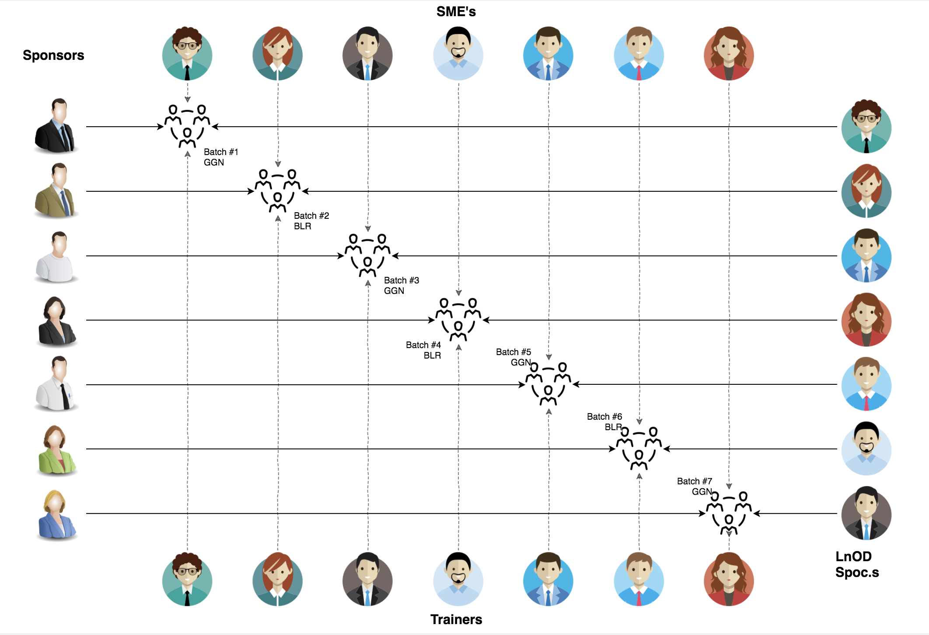
STAKEHOLDERS
Sponsors
Flipkart Pvt Ltd.
SME’s
Amit Balyan
Coordinators
Deepika Gajaraj
Shree Lakshmi
Notes:
30 sec

Slide 4

AGENDA
OUR JOURNEY
OUR TEAM
PROBLEM GOALS
ENGINEERING PRACTICES
TECH STACK
DEVELOPMENT
CHALLENGES AND LEARNING
DEMO
QUESTIONS
Notes:
30 sec

Slide 5
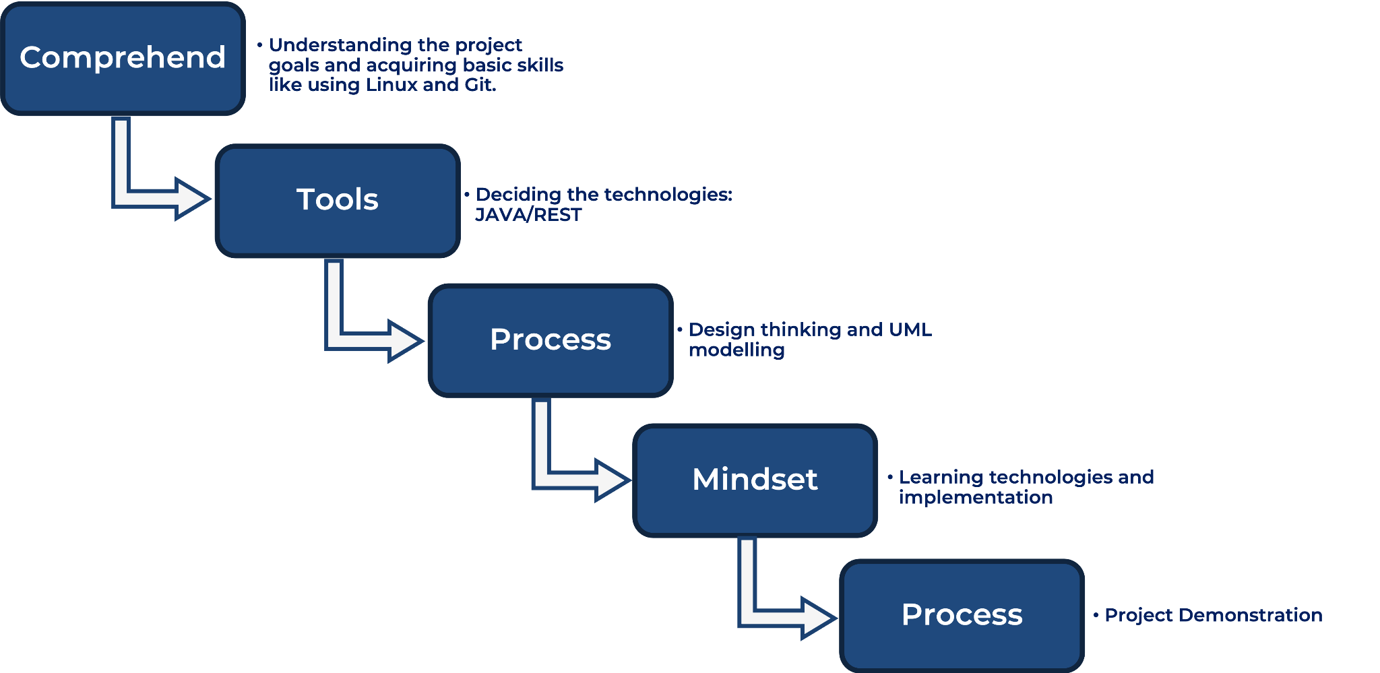
OUR JOURNEY
Notes:
2 mins

Slide 6
2 WEEKS OF TRAINING + PROJECT DEMO
12 DAYS
96 HOURS
5760 MINUTES
345600 SECONDS
LIMITLESS KNOWLEDGE
Notes:
30 sec

Slide 7
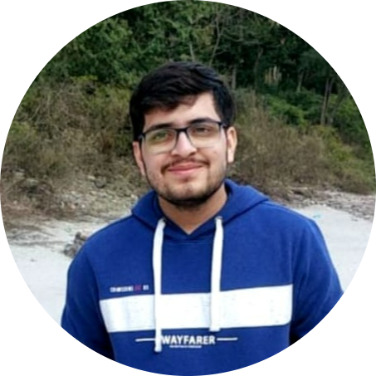

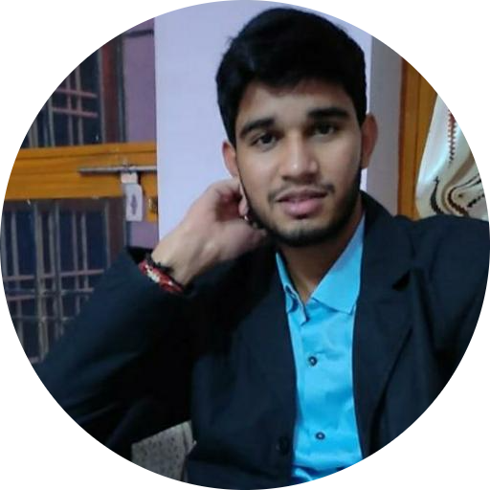
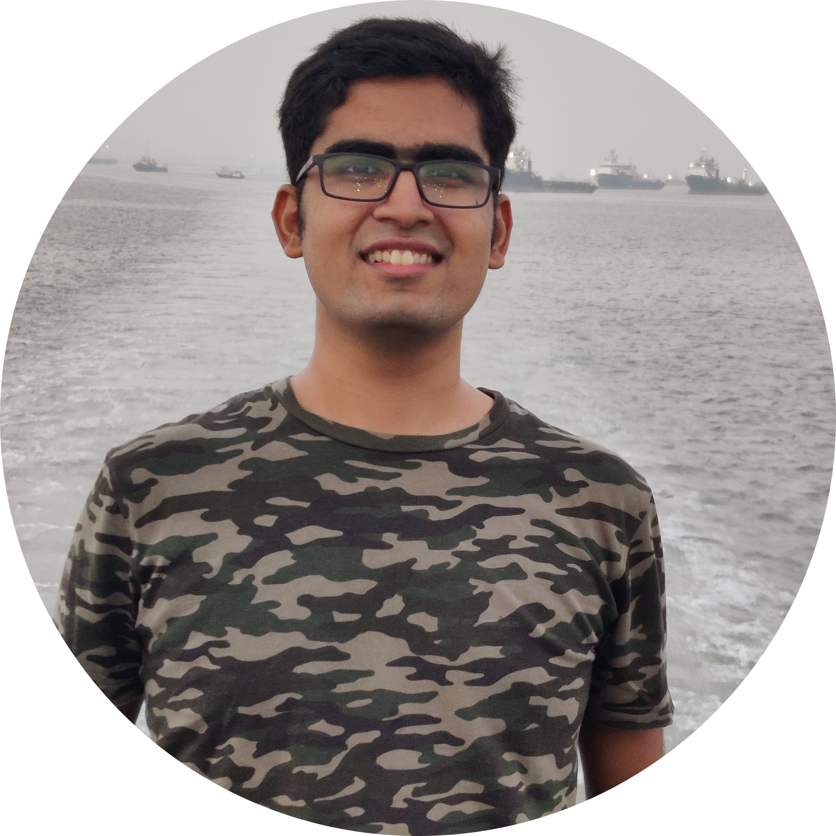
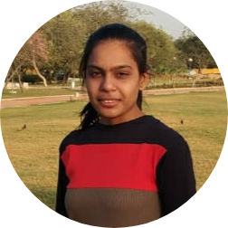
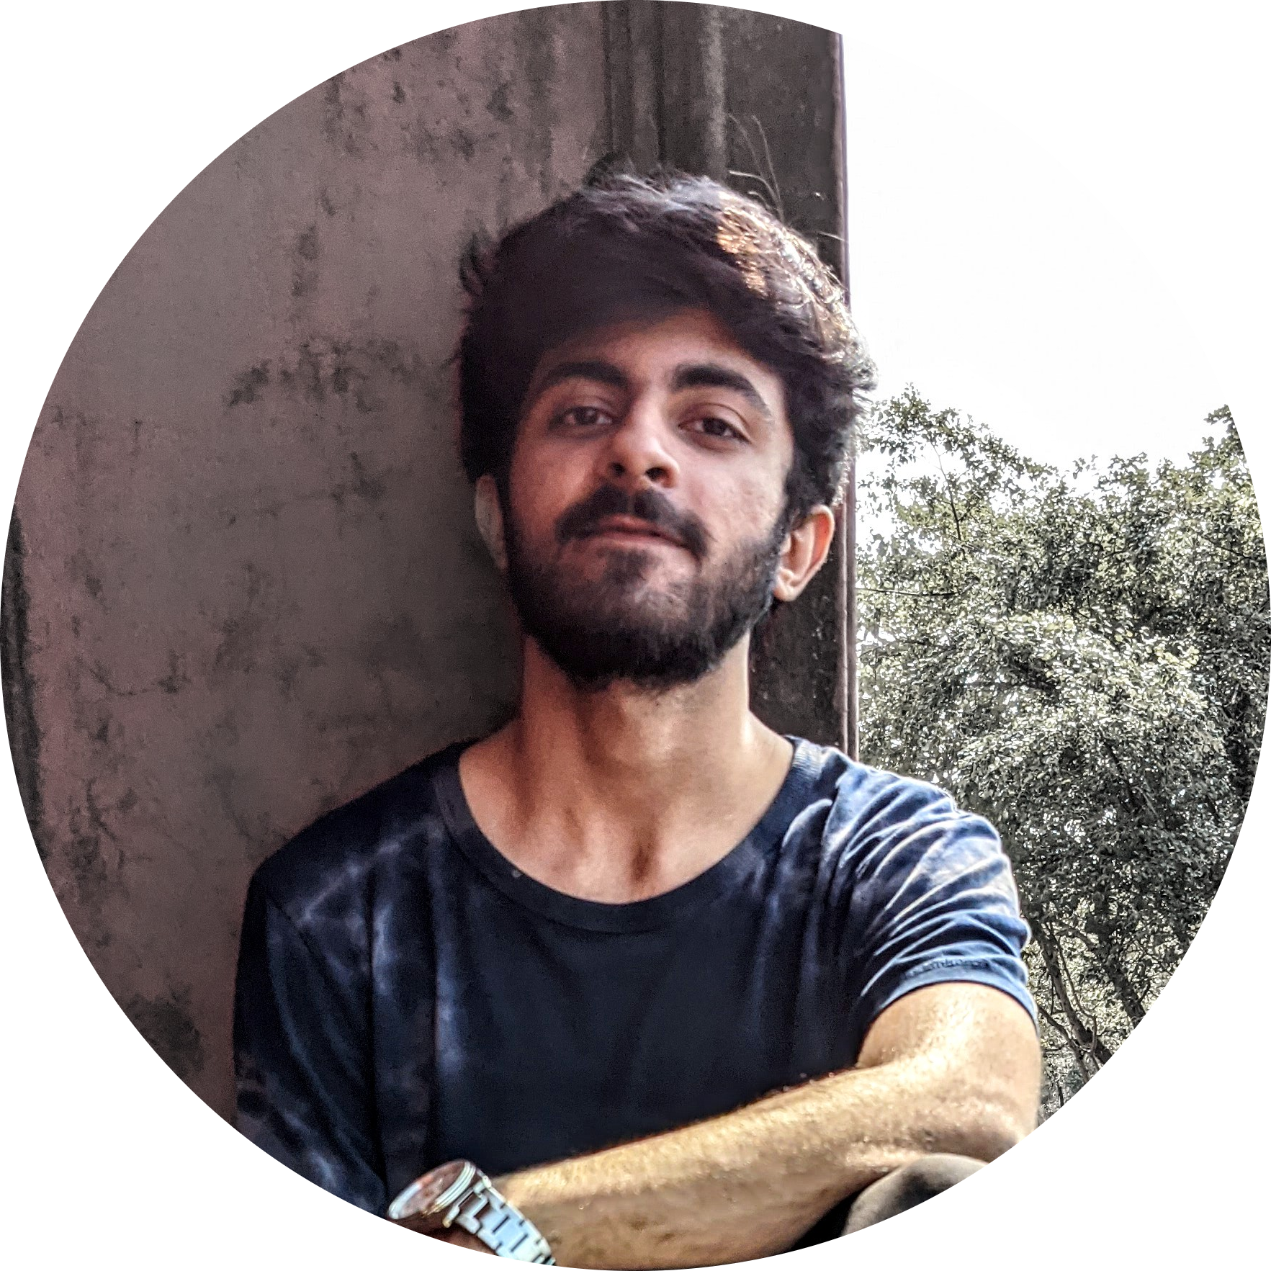
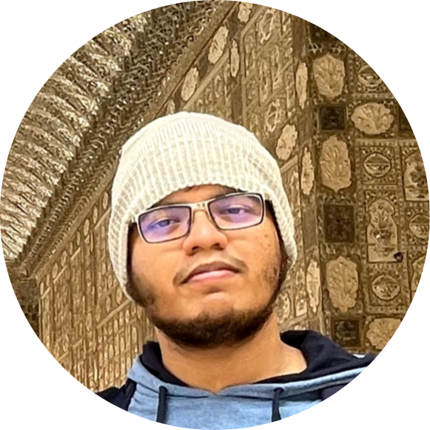
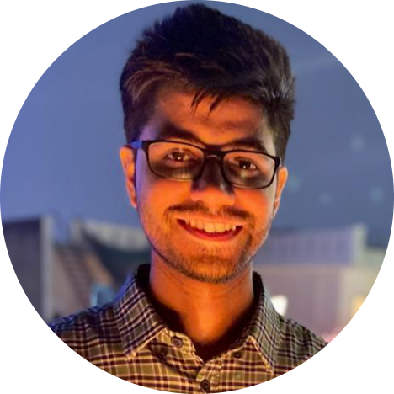
OUR TEAM
Shubham
Divya
Vivek
Aditya
Janvi
Jashandeep
Sushane
Tushar
Notes:
30 sec

Slide 8




OUR VISION
Quality
Security
To create a Course Registration System which delivers a secure and interactive experience for the user adopting JAVA tech stack and Rest API/Dropwizard Framework.
Interactivity
Speed
Notes:
30 sec

Slide 9

To create COURSE REGISTRATION SYSTEM using Java where a student can…
Choose courses followed by registration.
Use different modes of payment for the registration
View their grade card at the end of semester
PROJECT GOALS
Other primary actors of the project includes professor and administrator
Professor can choose subjects to teach and grade students.
Admin manages the administration.
Notes:
2 mins

Slide 10

ENGINEERING
PRACTICES\

Slide 11
SOFTWARE DEVELOPMENT LIFECYCLE : SDLC
Project Delivery
Integrate, deploy, test, documentation
Project Implementation
Development , Code Review, Commit
Software Development Life Cycle (SDLC) is a process used by the software industry to
design, develop and test high quality softwares.
Project Grooming
Requirement understanding, analysis and estimation
Project Planning
Understanding scope and goals of project, UML modelling and database designing
Notes:
2 mins

Slide 12
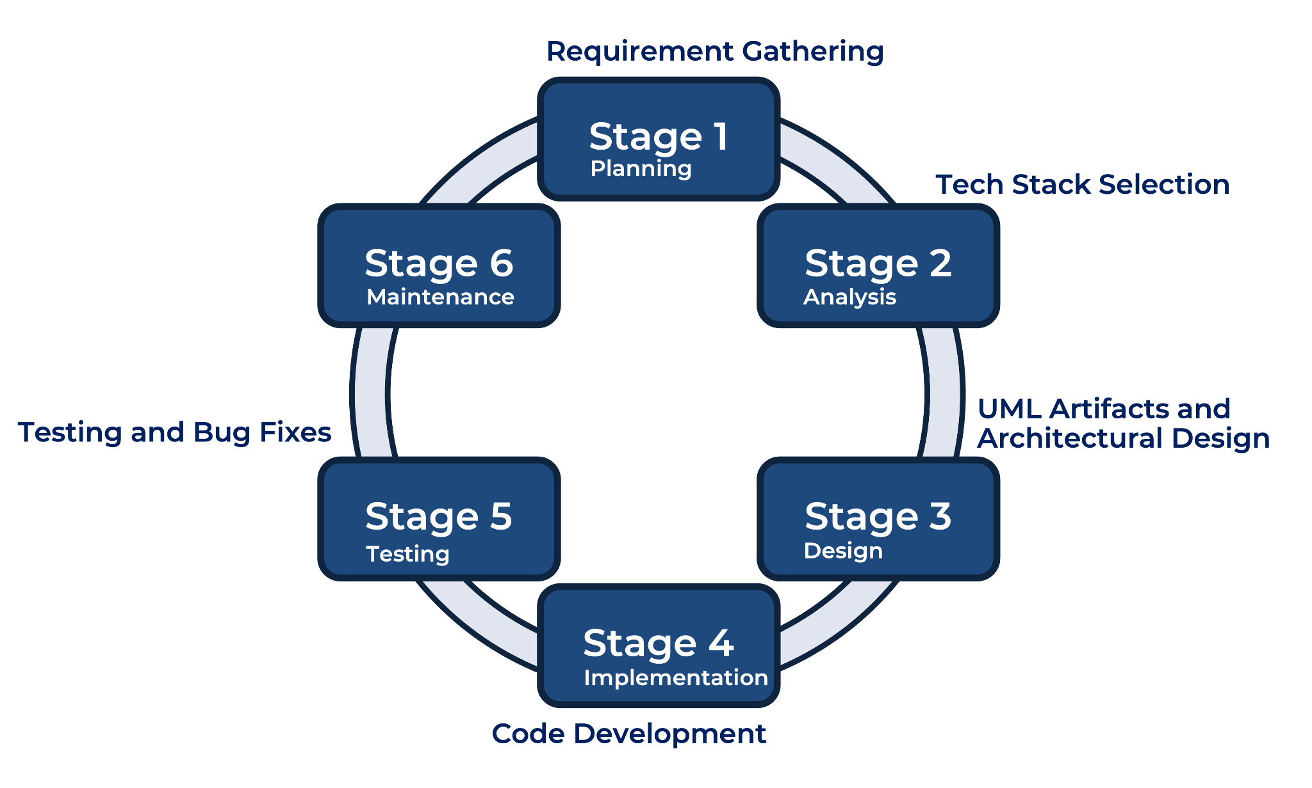
Notes:
1.5 min

Slide 13

1. Planning
6. Maintenance
DEVELOPMENT
2. Analysis
3. Design
4. Implementation

Slide 14





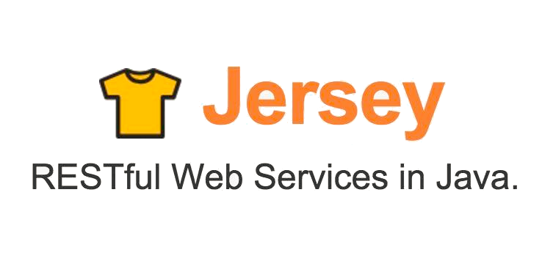





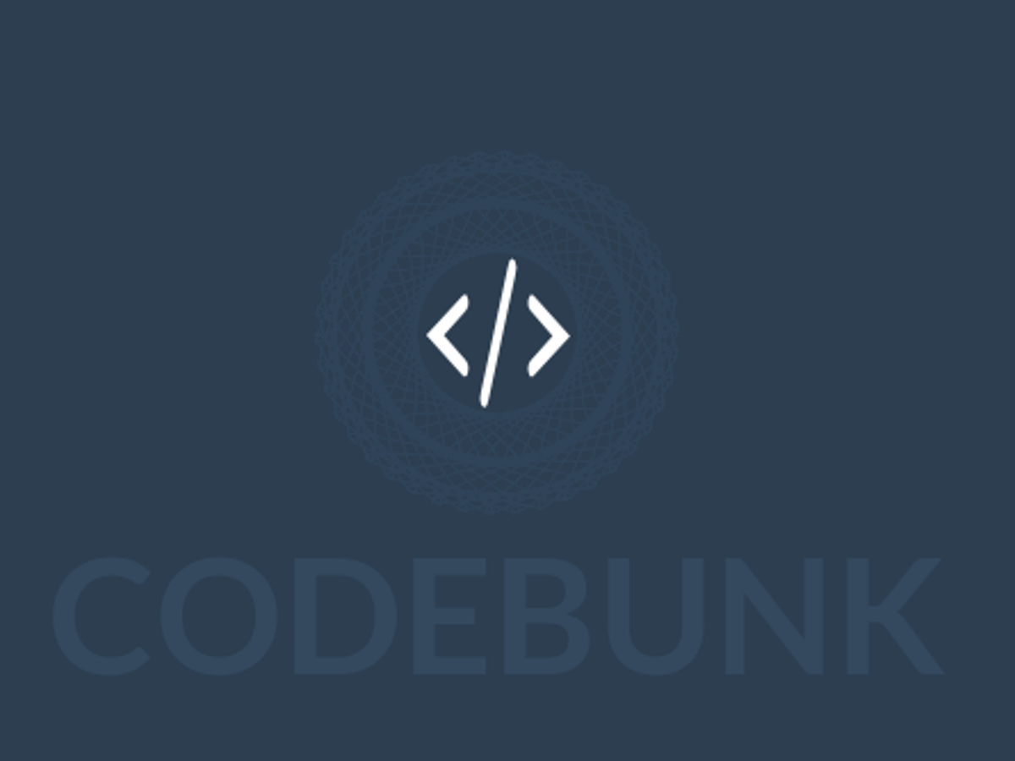


Tech Stack
Designing
Backend
Testing
Data
SCM
Notes:
1 min

Slide 15
FLOW OF PROJECT
JAVA POS
REST JERSEY
DROPWIZARD

Slide 16
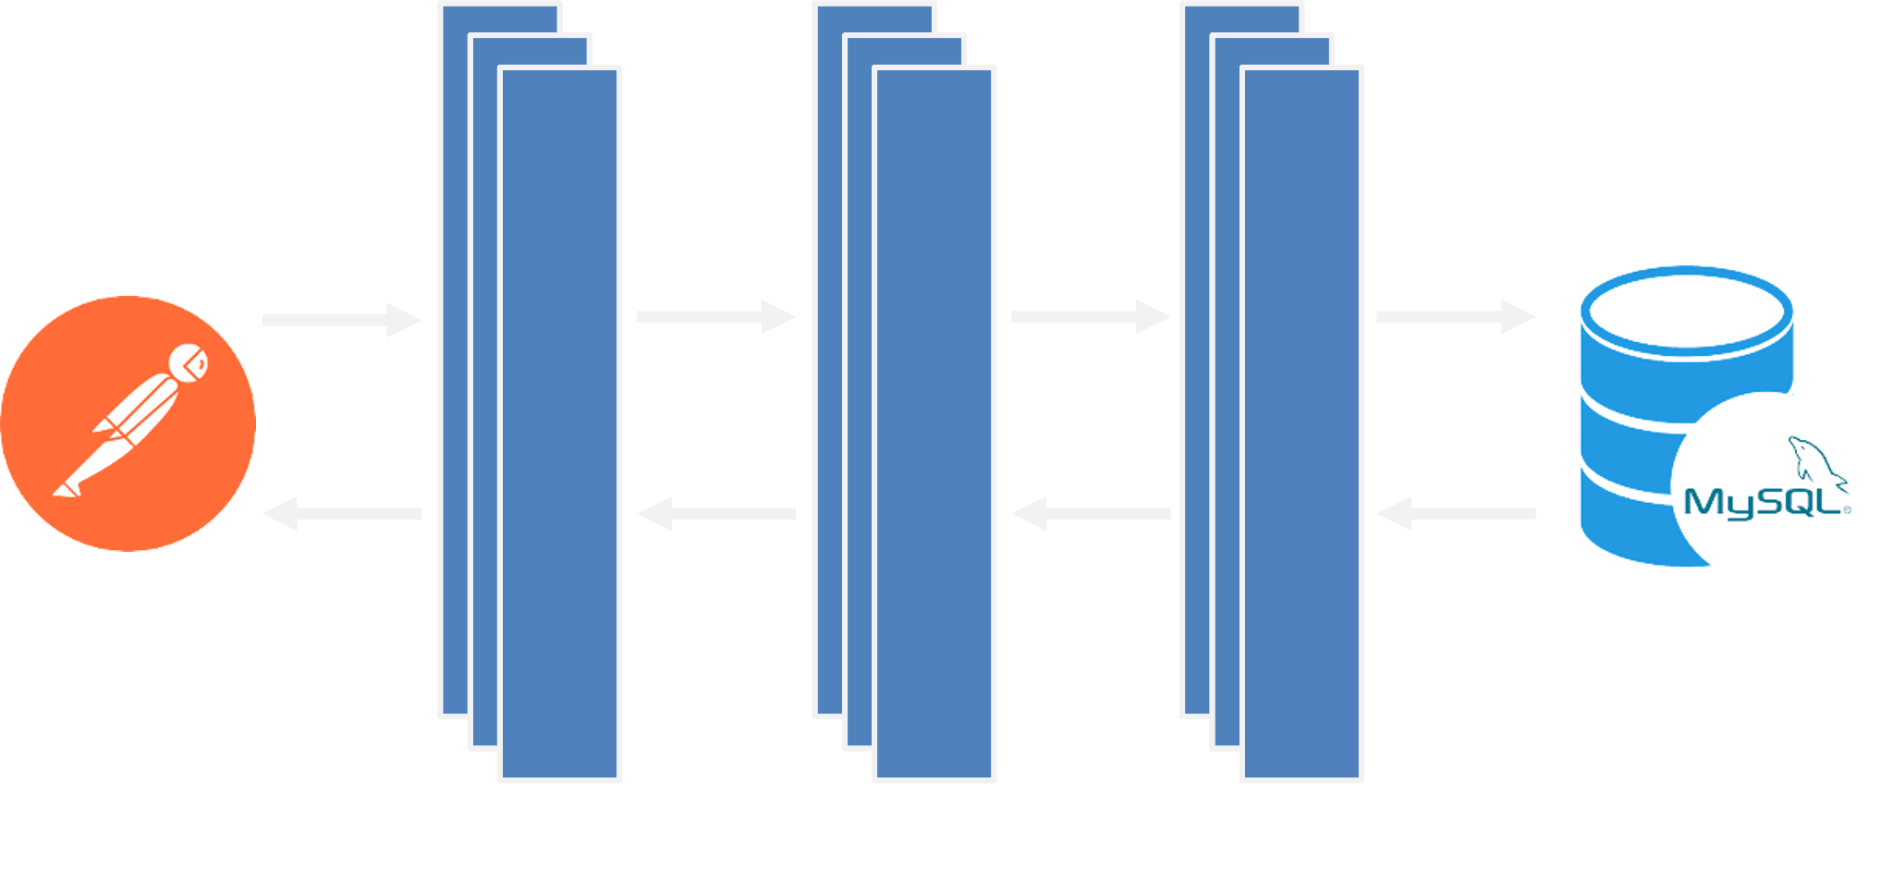
SYSTEM ARCHITECTURE
Notes:
2 mins

Slide 17

CHALLENGES
AND LEARNINGS

Slide 18
Understanding the problem statement and the initial implementation using Use Case, Activity, Sequence and Class Diagram.
Conflicts while merging and collaboration
Resolving jar and version dependencies
Migration of project from one tech stack to another
Working in an online environment
CHALLENGES
Notes:
1 min

Slide 19
Familiarization with Unix and Git Commands.
Software development life cycle and team work
Knowledge of Use case, Activity, Sequence and Class Diagram
Learning and Implementing new Java 8 features
Integration of REST Services with Java code using Tomcat and Jersey.
Integration of REST services with Java code
Dropwizard Integration
Usages of Postman for testing APIs
LEARNINGS
Notes:
2 mins

Slide 20
Let’s start with the Demo
POS Application
REST API Application
Dropwizard Application

Slide 21

Any Questions ?

Slide 22

Thank You !

